Slide 1
Terraform

Slide 2
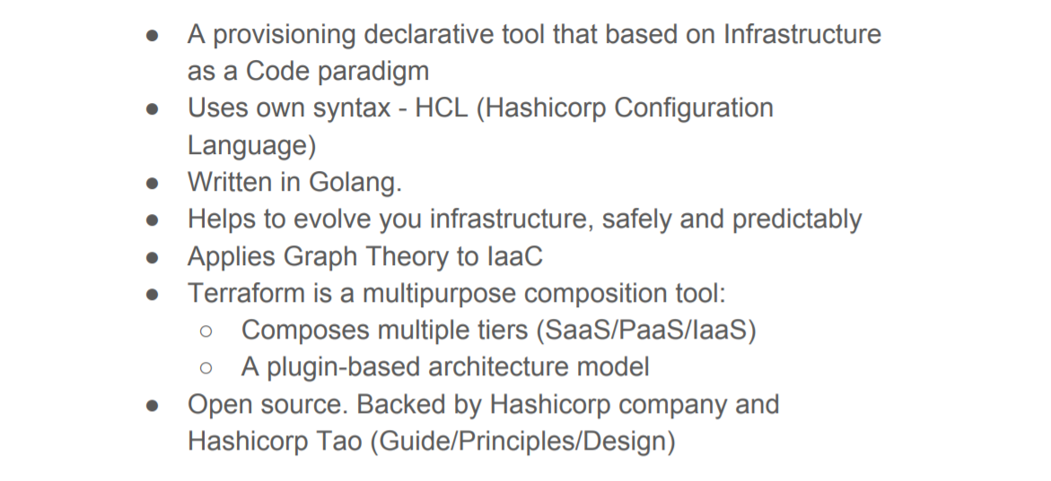
Terraform

Slide 3
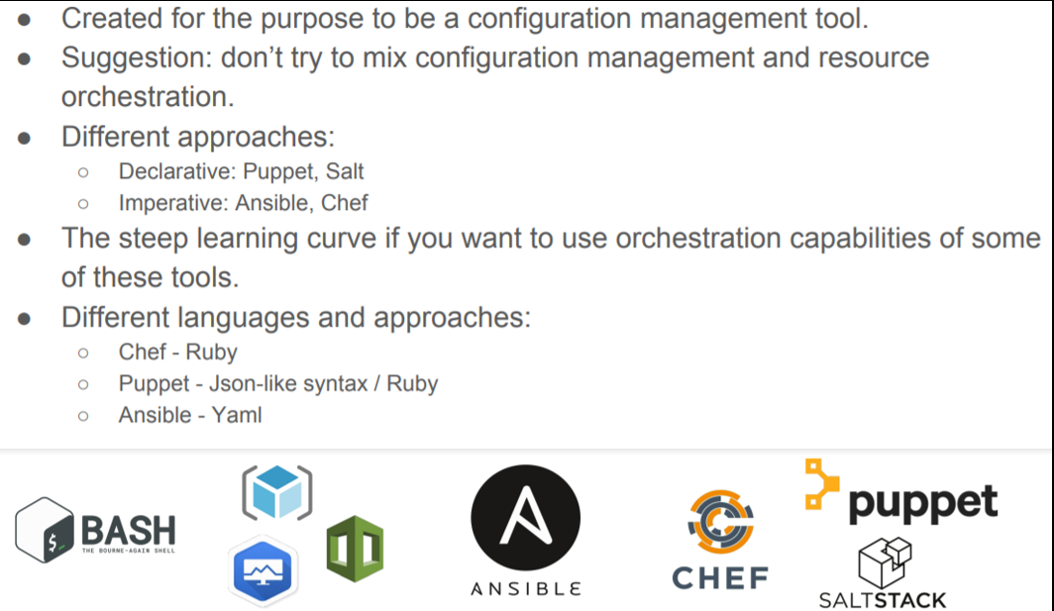
Comparison with other tools
https://medium.com/clarusway/imperative-approach-and-declarative-approach-in-automation-72cdfe82b1ae

Slide 4
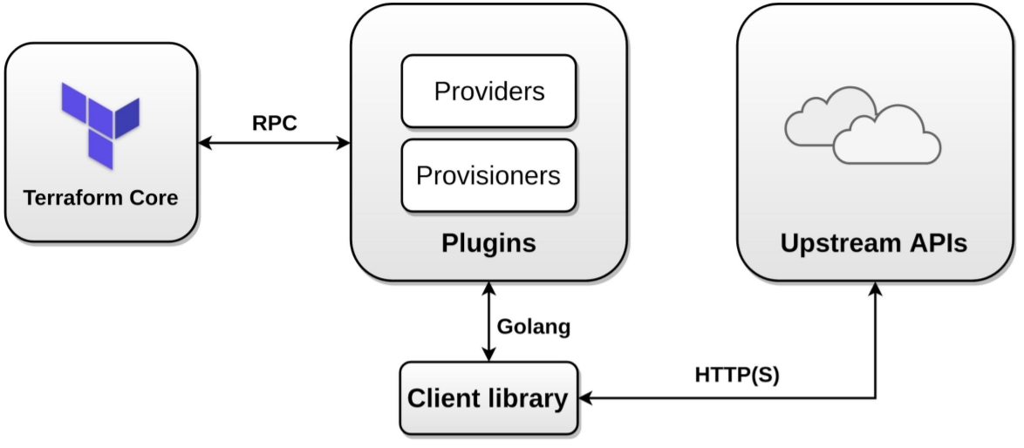
Terraform Architecture

Slide 5
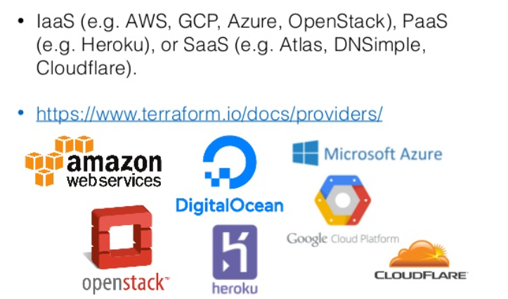
Terraform Providers

Slide 6
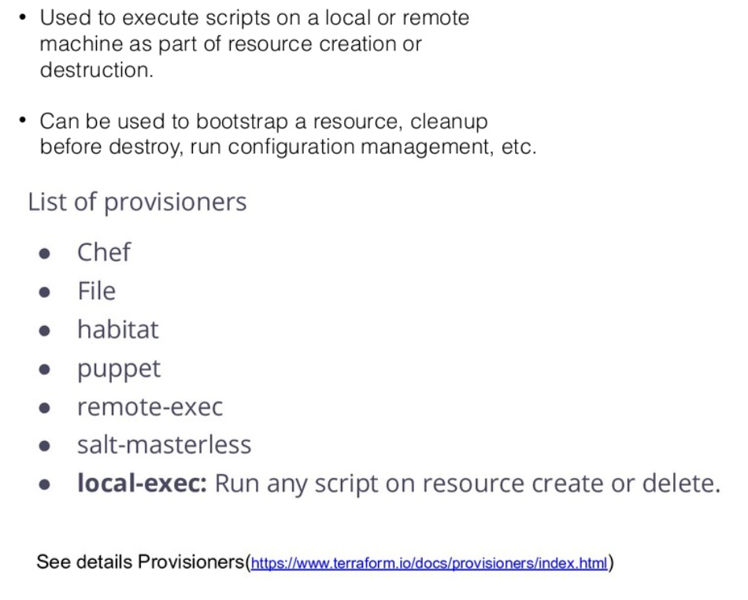
Terraform Provisioners

Slide 7
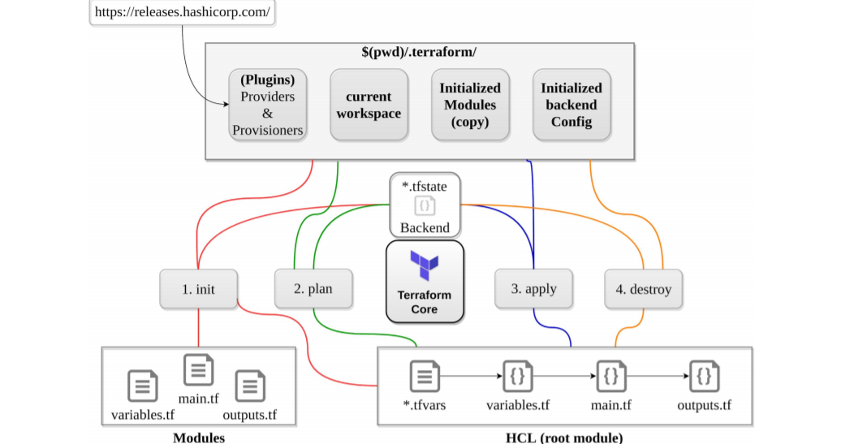
Terraform Workflow

Slide 8
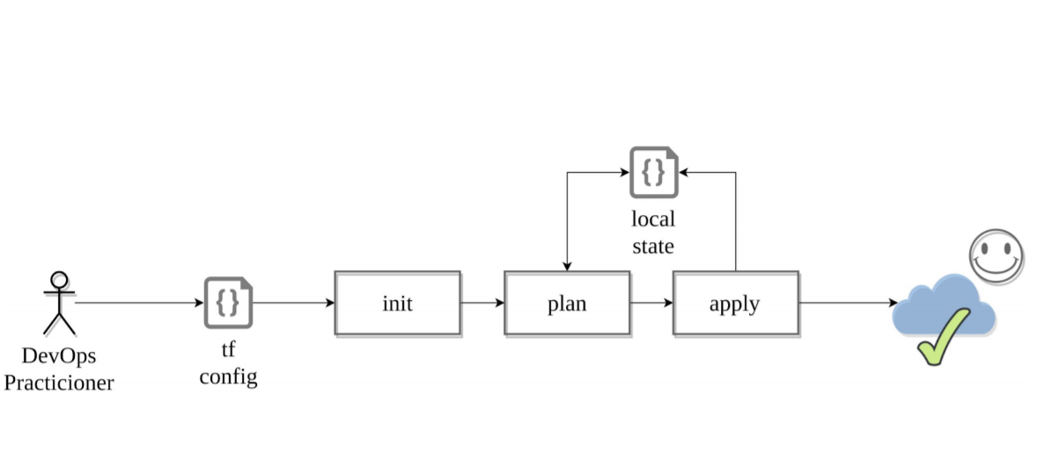
Terraform Workflow – adoption stages

Slide 9
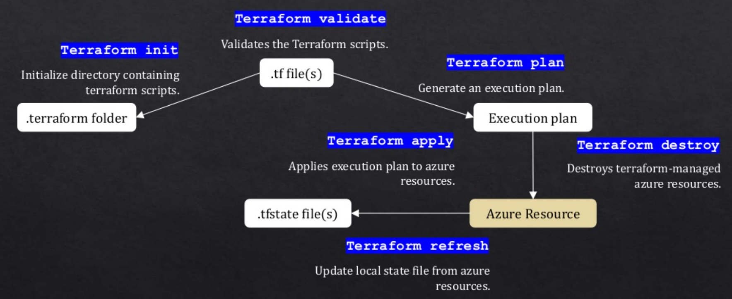
Terraform commands

Slide 10
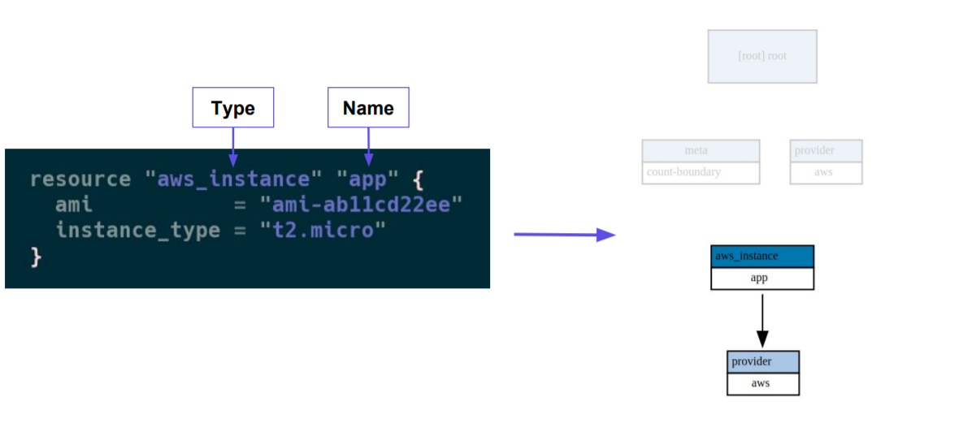
Terraform Example

